Slide 1
Schwab Royale Using Multi Agent Deep Q-Learning Approach
Members
22BCE7836-Harshith Manikhanta
22BCE7137-Sai Prudhvi Ram

Slide 2
About the project
Schwab Royale is an innovative multi-agent battle royale game designed to test and develop reinforcement learning strategies in competitive and cooperative settings.Schwab Royale introduces AI-controlled agents that must navigate a dynamic battlefield, making strategic decisions to survive and eliminate opponents
Multi-Team, Multi-Agent Gameplay: Agents compete as individuals while also collaborating with teammates to eliminate other teams.
Hybrid Reward System: Agents receive individual rewards for kills but also share team-based rewards when eliminating entire opposing teams.
Diverse Agent Roles: Agents can have specialized abilities, such as fighters, healers, or necromancers, creating varied team dynamics.
Adaptive AI Strategies: The game leverages reinforcement learning techniques, allowing agents to learn from experience and improve decision-making over time.

Slide 3
Existing work
The original project consisted of the following components:
model.py:
Basic Q-learning with experience replay and target Q-networks.
Implements saving of the model's state.
agent.py:
Defines an RL agent that uses an epsilon-greedy strategy to explore the environment.
Integrates state extraction methods specific to the game.
game.py:
Implements the game environment using Pytorch.
Contains methods for updating the strategies.
Manages game loops and game over conditions.
function.py:
Agent Moves ,Attacks and strategies
Each agent has a specific role:
H = Healer
N = Necromance
S = Slayer
Training.py:
Applying basic Q learning and training the model

Slide 4
Modifications done to the existing work
The key modifications made to the project include:
Transition from Basic Q learning to Multi Agent :
Removed elements specific to Q-learning such as target networks, memory replay, and reward discounting.
MAQ Learning allows each agent in a team to learn its own Q-values while considering the presence of other agents. Since SchwabRoyale is a multi-team, multi-agent battle royale, agents need to coordinate with teammates and compete with opponents, which MAQ Learning supports naturally
Easy Multi-Agent Extension :
Gym provides a consistent interface which makes it easier to plug into RL algorithms (like DQN) without worrying about environment compatibility.
Our custom multi-agent wrapper over Gym, where each agent receives its own observation and chooses an action, but the environment steps forward jointly.
Reward Structuring and Visibility Constraints :
Incorporated sparse and shaped rewards based on kills and team eliminations. Simulated partial observability to mimic limited vision and enhance realistic decision-making..
Exploration and Learning Enhancements :
Integrated epsilon-greedy exploration along with team-aware behaviors. Laid groundwork for curiosity-driven exploration and curriculum learning to guide agents from simpler scenarios to complex ones.
Agent Diversity and Emergent Behavior Research :
Planned variations in agent behavior using parameters like selfishness and team reward per capita to study emergent strategies such as cooperation, spite, or betrayal. Set up infrastructure to explore mean field approximations and agent communication protocols.

Slide 5
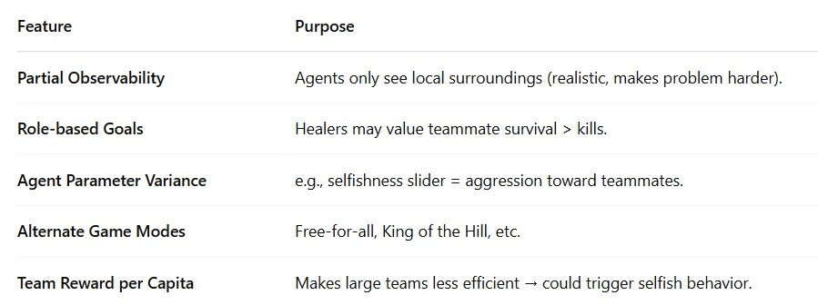
Results – existing work
In the original implementation, results were as follows:
Learning Approach:
The Q-learning based agent gradually learned to improve its score through repeated gameplay.
Epsilon-greedy action selection, along with replay memory and target network updates, were used to train the agent.
Performance Issue :
With multiple agents, the replay buffer fills up fast and can contain redundant or low-quality data.
The team strategies exploration was limited, sometimes leading to suboptimal paths that did not consistently reach the high reward
Game Speed:
The snake moved relatively slowly, which provided ample time for training but did not fully stress-test the agent’s performance in a real-time setting.

Slide 6
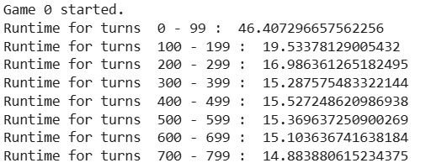
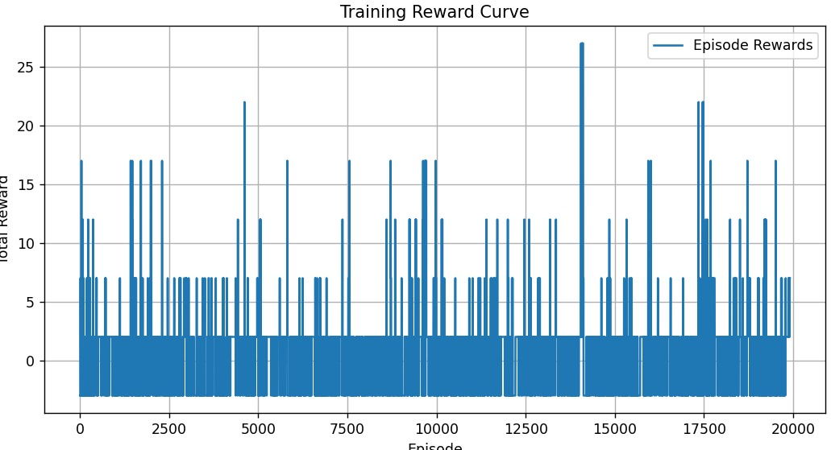
Results – existing work

Slide 7
Results – Modified work
The modifications brought about the following improvements:
Enhanced Exploration-Exploitation Balance:
By gradually decaying ε and reinforcing smarter exploratory moves, agents learned to shift smoothly from trial-and-error to exploiting learned policies.This reduced the chances of agents getting stuck in non-beneficial cycles and encouraged exploration of effective team-level tactics.
Reward-Driven Learning with Prioritization:
The use of Prioritized Experience Replay allowed agents to learn more from impactful transitions (e.g., high-reward kills or team wins).
This accelerated the learning process and helped agents focus on correcting important mistakes
Team-Based Reward Tracking:
Introducing per-team reward tracking enabled a better analysis of performance across episodes.
Visualization of reward curves showed consistent improvement, with some teams outperforming others based on strategy.
Model Evaluation and Visualization:
Post-training evaluation allowed comparison of average rewards across teams, highlighting which strategy was most effective.
Reward plots provided visual evidence of learning progression, useful for debugging and tuning.

Slide 8
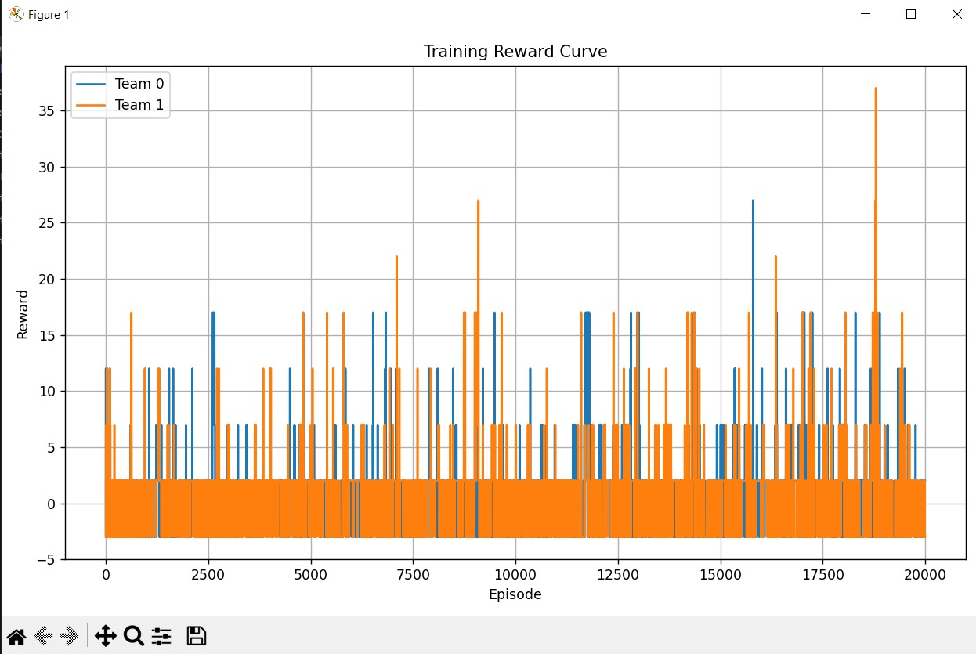
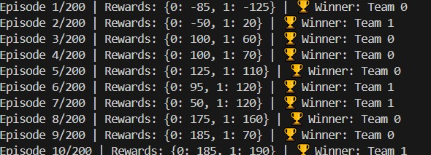
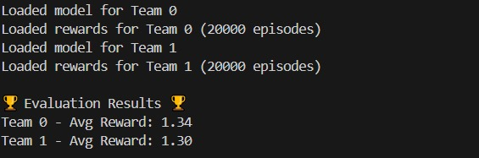
Results – Modified work

Slide 9
References
[1] Y. Yang, R. Luo, M. Li, et al., “Mean Field Multi-Agent Reinforcement Learning,” Proceedings of the 35th International Conference on Machine Learning (ICML), 2018. papers.nips.cc
[2] J. Foerster, G. Farquhar, T. Afouras, et al., “Counterfactual Multi-Agent Policy Gradients,” Proceedings of the AAAI Conference on Artificial Intelligence, vol. 32, no. 1, 2018. AAAI
[3] L. Busoniu, R. Babuska, and B. De Schutter, “A Comprehensive Survey of Multiagent Reinforcement Learning,” IEEE Transactions on Systems, Man, and Cybernetics, vol. 38, no. 2, pp. 156–172, 2008. ieeexplore.ieee.org
[4] M. Tan, “Multi-Agent Reinforcement Learning: Independent vs. Cooperative Agents,” Proceedings of the Tenth International Conference on Machine Learning (ICML), 1993. cs.cmu.edu
[5] H. Vinyals, I. Babuschkin, W. Czarnecki, et al., “Grandmaster Level in StarCraft II using Multi-Agent Reinforcement Learning,” Nature, vol. 575, no. 7782, pp. 350–354, 2019. Nature.com
[6] M. L. Littman, “Markov Games as a Framework for Multi-Agent Reinforcement Learning,” Machine Learning Proceedings 1994, pp. 157–163. doi.org
[7] N. Zhou, “Teaching an AI to Play Snake Using Deep Reinforcement Learning,” Medium, 2021. Medium
[8] OpenAI, “Multi-Agent Hide and Seek,” OpenAI Blog, 2019. openai.com

